Slide 1
LESSON TWO:
Joyous Victory In The Midst Of PEOPLE
(Philippians 2)

Slide 2
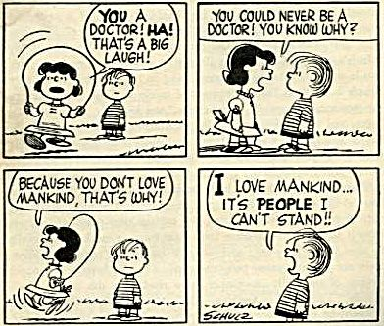

Slide 3
Problem People rob us of joy
Psalm 28:3, “who speak peace with their neighbors, while evil is in their hearts.”
Psalm 43:2, “I go mourning because of the oppression of the enemy?”
Psalm 109:3, “words of hatred, and fought against me without cause.”

Slide 4
Joy IS Robbed (Psalm 39:3)
Wounds deeply; Emotions are rubbed raw
Suffer physiologically
Wrong sticks in your mind; sours your entire life
Keeps gnawing at you; emotions build and you explode.

Slide 5
“Philippians 2 is an amazing narrative teaching us how to deal with those ornery, irritating, obnoxious people that plague our lives.”

Slide 6
2:1-4, the COMMAND—Unity
Mankind is created as a social being
God expects His People to be sociable
We share “fellowship”
1 Corinthians 12:12-26

Slide 7
Four Basic Truths
"Encouragement in Christ"
"Consolation of love"
"Fellowship of the Spirit"
"Affection and compassion"

Slide 8
Connected with others—The how (verse 2)
“Same mind”
“Same love”
“One accord,” “united in spirit”
“One mind,” “intent on one purpose”
The “how” requires diligent effort and great patience

Slide 9
Piercing Questions…
How are you following verses 3-4?
Are you unselfish and humble in all relationships?

Slide 10
2:5-11, the KEY—imitating Jesus
Unselfishness (verse 6)
Humility (verse 7a)
Service (v. 7a)
Sacrificial Attitude (v. 7)
Perfect Obedience (v. 8)
Glorifies (v.11)

Slide 11
The simplicity of guarding against your joy being stolen by irritating people is stated: “You have this attitude that Christ demonstrated”!

Slide 12
2:12-18, the CONCEPT—"sacrifice"
Safeguarding your personal joy is your personal choice.
YOU must “work out your salvation with fear and trembling” (verse 12).

Slide 13
The burden is upon YOU
Do not think THEY…
Have to change to suit your preferences.
Are totally wrong.
Are inferior to you
Interaction involves “work”!

Slide 14
You Must…
Allow God to “work in you” (verse 13)
“Prove” (verses 14-16)
“Share the joy” (verses 17-18)

Slide 15
2:19-30, the EXAMPLE—Timothy
A person of commendation (verse 19a).
A man of positive nature (verse 19b).
A person of strong, sincere concern (verse 20).
A man of outstanding commitment to Christ (verse 21, cf. verse 20a).

Slide 16
2:19-30, the EXAMPLE—Epaphroditus
New relationships (verse 25)
New responsibilities (verses 26-28)
Wonderful blessings (verses 29-30)

Slide 17
The Personal Application
Self-justification of avoidance only causes you to lose joy
A decision NOT to accept people that you do not like places you in dramatic contrast with Christ, Timothy and Epaphroditus!

Slide 18
The Christian finds joy in the presence of irritating people because he anxiously serves not wanting to be served (Philippians 2:3).
“
”

Slide 19
A practical reality…
You can choose to act so that division and disrespect for his/her personal value is evidenced.
Or you can choose to act with the same attitude that Christ demonstrated: “just as the Lord…so also should you” (Colossians 3:12-13).

Slide 20
When you think of the most problematic person plaguing your life, what choice will you make—one choice banishes joy and the other choice provides the environment in which abundant joy will flourish.

Slide 21
Romans 12:18
“If possible, so far as it depends on you, be at peace with all men.”
Reality— “if possible”
Limits—“so far”
Action—“depends on you”
Scope—“all men”

Slide 22
Next Lesson…
The Christian has a Joyous Victory THINGS! (Philippians 3)

