Slide 1
A Portrayal of Perplexity
1

Slide 2
GOD’S DIRECTIVES FOR THE CHRISTIAN
His soul’s salvation
His personal relationships
His dual citizenship duties
The Christian struggles against despair when these duty areas are corrupted by sin!

Slide 3
When despair’s perplexity strikes...
Despair overcomes the Christian
Faith in Jehovah is shaken
Trust in God is shattered

Slide 4
“Is God really in control?”

Slide 5
Is God is in control of civil governing?
Do laws uphold God’s righteousness?
Suppress and punish the wrong ?
Do they protect the righteous & innocent ?

Slide 6
These should be the fruits of a society whose governing honors biblical principles…
But this is not always evident (Jer. 12:1-4; Ps. 73:1-14; Rev. 6:10)

Slide 7
Modern Society fuels despair
Abortion is the sacred cow of Progressives
Corrupt politicians
Jehovah’s righteousness is derided
A visible rejection of anything “holy”!

Slide 8
Habakkuk . . .
Could not understand how God would allow evil
Did not question God
Faith did not fit the visible facts of daily life
Full of perplexity and frustration
Grieved to see the powerlessness of the law, crookedness of justice, entrapping of the righteous by the wicked

Slide 9
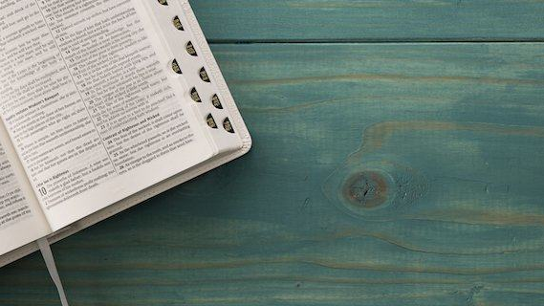
Habakkuk Speaks Today…
Going from perplexing doubt to confident understanding is a pattern for us!

Slide 10
Question #1: Is There Civil Justice?
(Habakkuk 1:1-4)

Slide 11
Is There Civil Justice?
It seemed God tolerated Judah's evil deeds (1:1-4)…
Why was so much evil and violence tolerated?
Why does God allow citizens to advocate, embrace and practice ungodliness in their nation?

Slide 12
Religion & Politics?
Silence hides your light, your salt loses savor, your leaven dies!
Speak out about sin in society (Numbers 5:6)
Speak out because of your zeal (Isaiah 62:1)
Speak out because sin’s fruits (Jeremiah 4:19)
Speak out when intimidated (Acts 18:9)
How can the Christian remain silent and please God?

Slide 13
Is There Civil Justice?
Answer:
Citizens will be judged
...but God is NOT tolerating evil (1:5-11)!
Jehovah IS interested in this world (Exodus 2:24-25; 3:7)

Slide 14
Look among the nations! Watch! Be horrified! Be frightened speechless! For I am accomplishing a work in your days—You would not believe it even if you were told!
(Habakkuk 1:5)

Slide 15
Question #2:— How can this be right?
(Habakkuk 1:12-2:1)

Slide 16
How can this be right?
Habakkuk was shocked at the excessive evil of Babylonia (1:12-2:1)
There had to be another way
The fact that Babylon was “more wicked” than Judah was relative.

Slide 17
Answer: The Lord is in His Holy Temple
God is not blind to sin (2:2-20)
All sin will be punished…NO ONE will evade the discerning eye of Jehovah God (2:4).
“Faith” is critical to our endurance
Absolute assurance is stated in 2:20

Slide 18
Consoling the Despondent Perplexity
There will be a universal Judgment on evil (3:1-16)
The triumphant resolution is proclaimed (3:17-19)

Slide 19
Take-Home Lessons
God expects His people to be vigilant citizens upholding righteousness.
Perplexity is fueled by this world but calmed by God’s Word (Eph 4:14).
God does not ignore evil – judgment is certainly coming! (3:3-15).
Tranquility can exist in the midst of distress (Job 13:15; Ps 73:26-28).

Slide 20
Concluding Consolation
Trust in God yields tranquility because God's trustworthiness is a historical fact.
Even in the midst of destruction and ruin, Habakkuk learned that one can trust God implicitly! He learned that God was not idle; that He was doing a wonderful work.

Slide 21
Behold, the Lord God helps Me…who fears the Lord, who obeys the voice of His servant, who walks in darkness and has no light? Let him trust in the name of the Lord and rely on his God
(Isaiah 50:9,10)

Slide 22
How confident is your trust in Jehovah God?
“Though my job goes…my health fails…the forces of evil have their own way…the economy doesn't work the way I want it to…the election doesn't work out the way I hope…I'm not appreciated among my friends…everything goes wrong, I won't pull the plug on You…I won't resent You Lord. I will have my doubts and questions about how You are working. I won't stop questioning—but there is one other thing that I won't stop doing either. I won't stop rejoicing in You. For You are my Rock and You are my strength.”

Slide 23
Next Lesson: An ancient book with a current query

